Slide 1

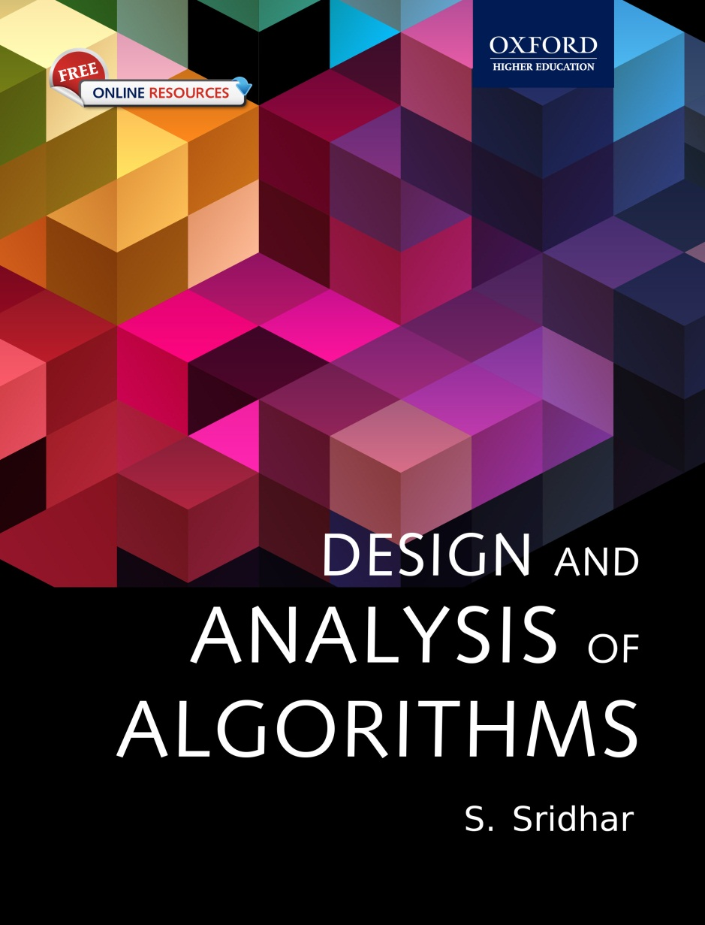
Design and Analysis of Algorithms
S. SRIDHAR

Slide 2
Chapter 8 Divide and Conquer

Slide 3
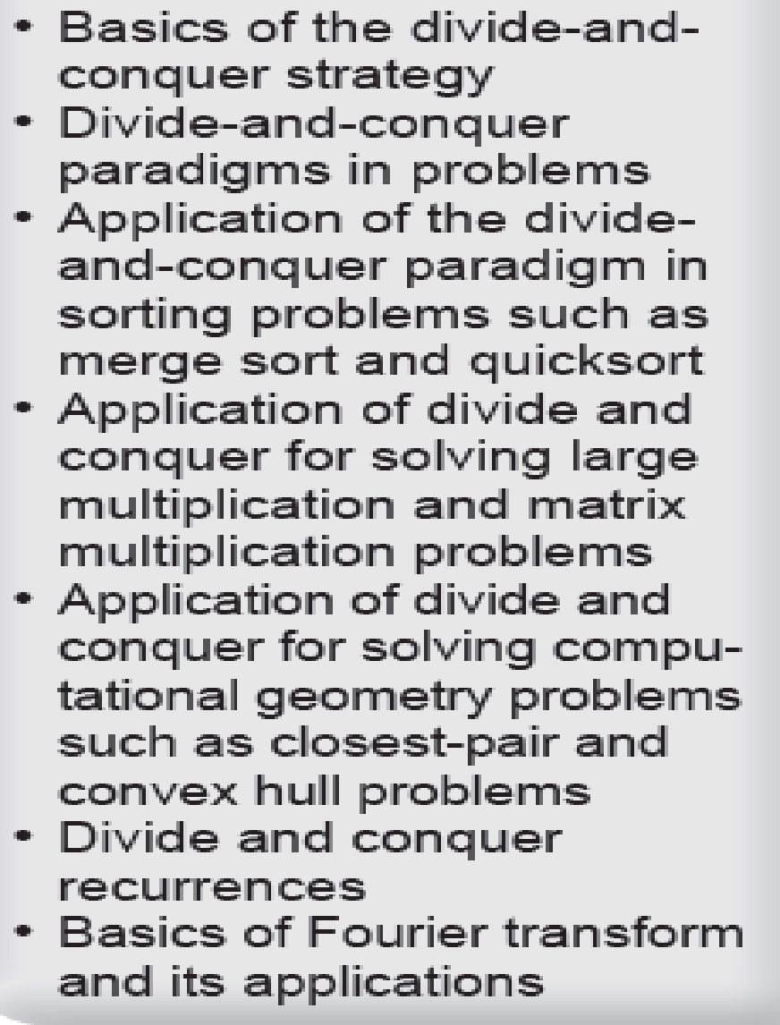
Objectives

Slide 4
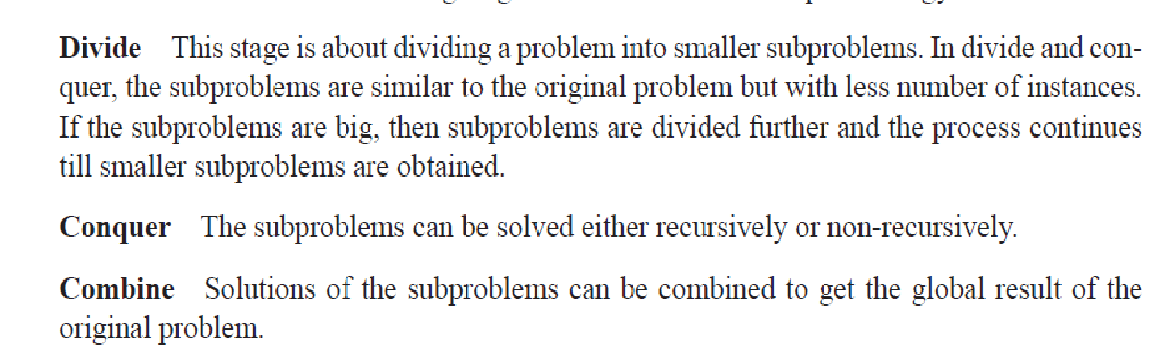
Strategy of Divide and Conquer

Slide 5
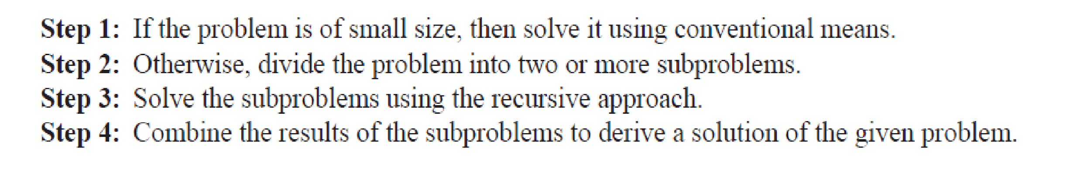
Procedure

Slide 6
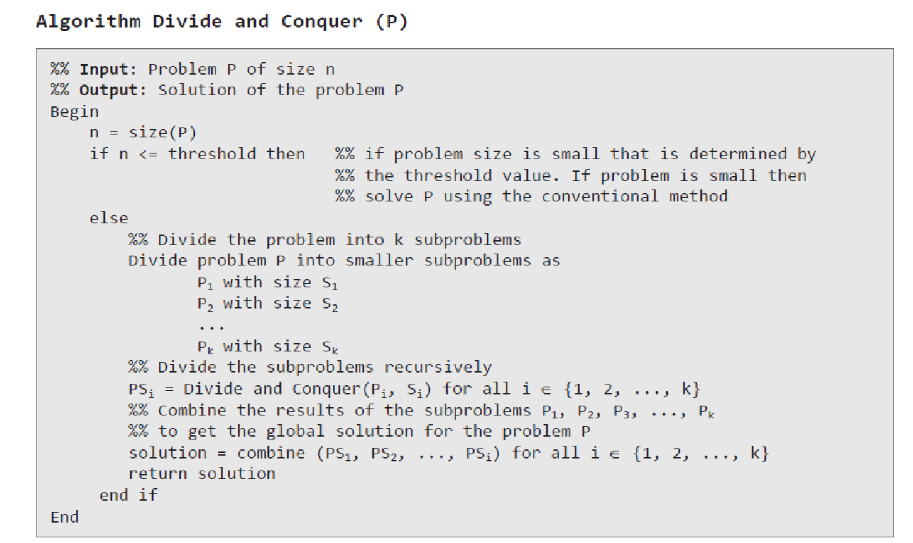
Formal Algorithm

Slide 7
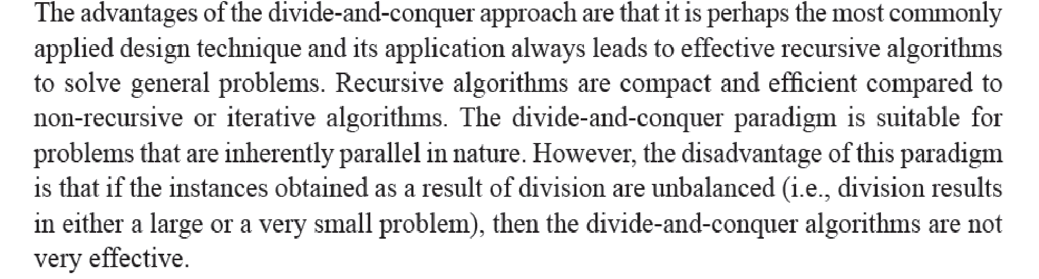
Advantages and Disadvantages

Slide 8
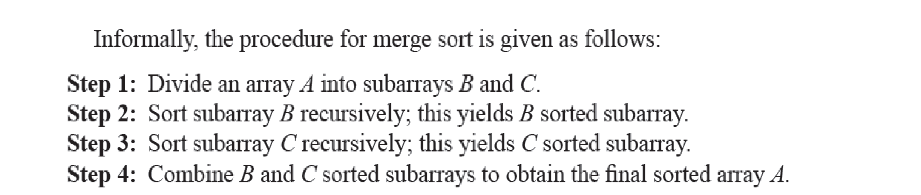
Merge Sort

Slide 9
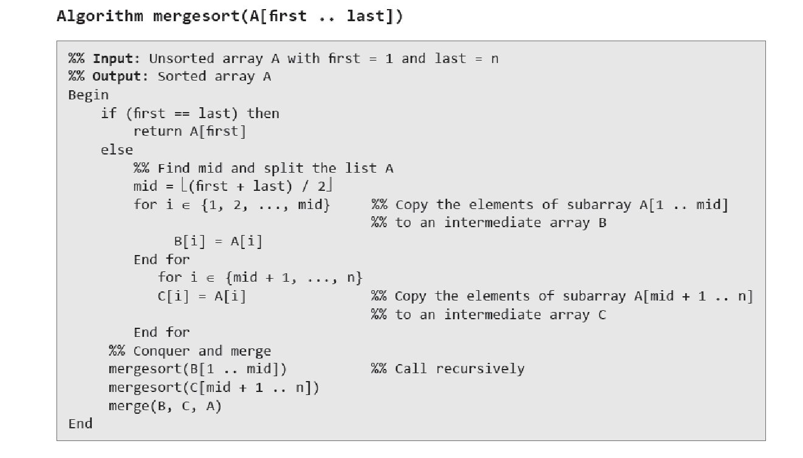
Formal Algorithm

Slide 10
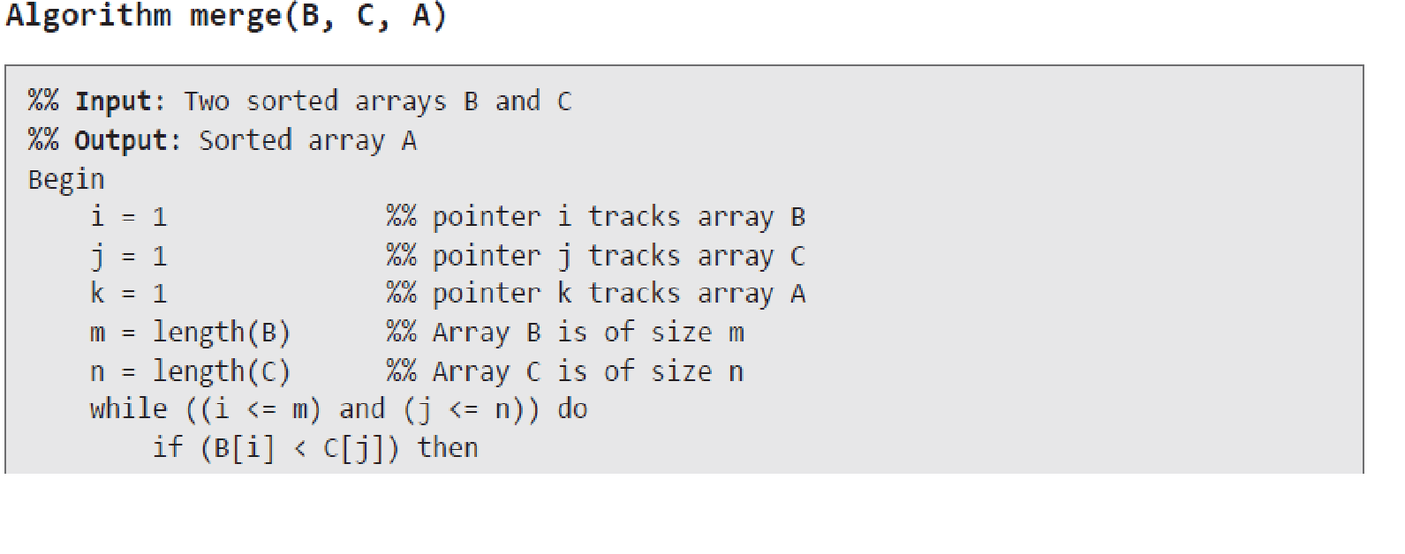
Formal Algorithm

Slide 11
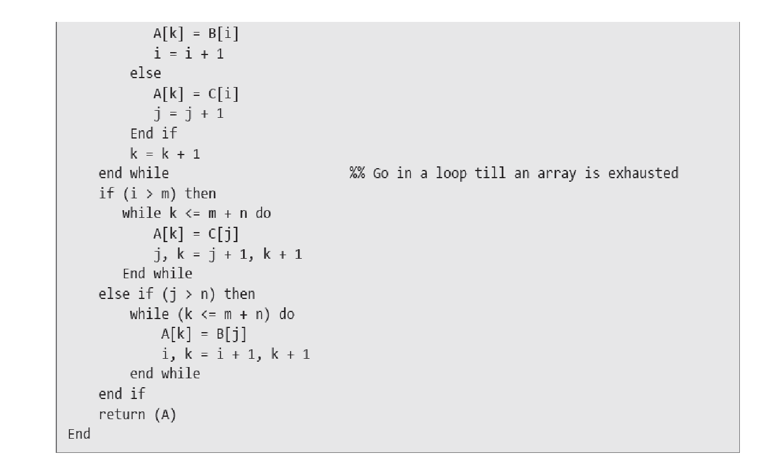
Formal Algorithm

Slide 12
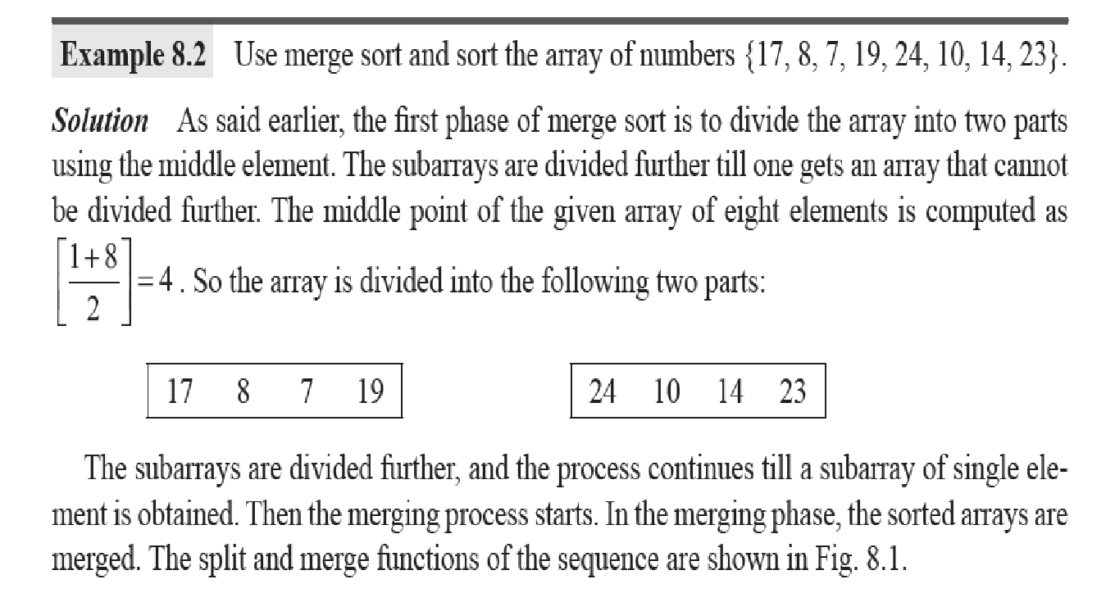
Formal Algorithm

Slide 13
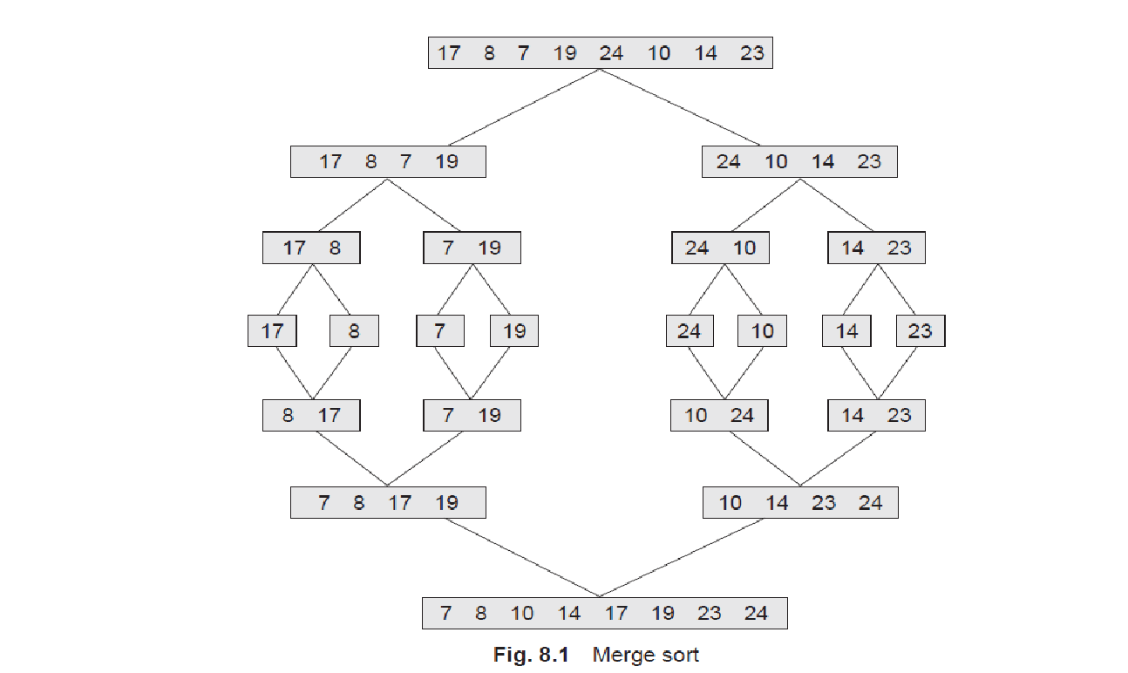
Merge Sort

Slide 14
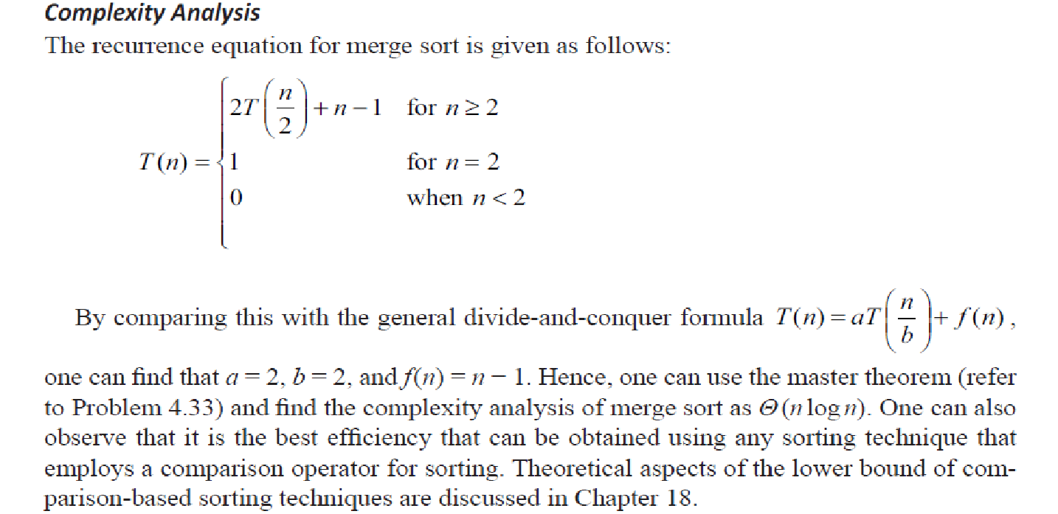
Complexity Analysis

Slide 15
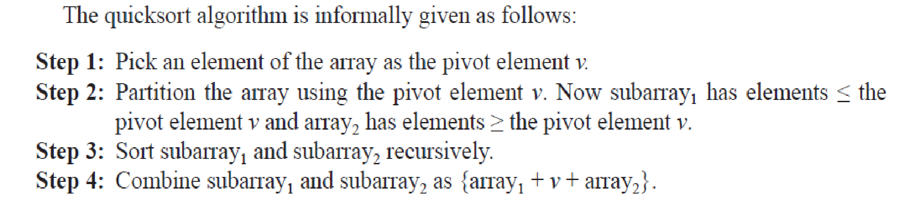
Quicksort

Slide 16
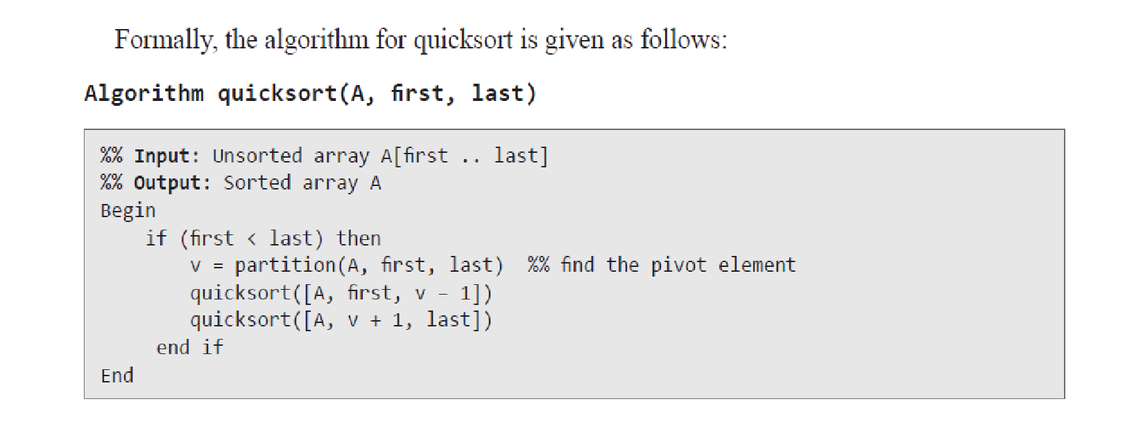
Quicksort Algorithm

Slide 17
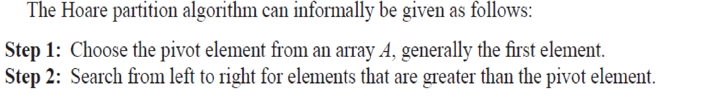
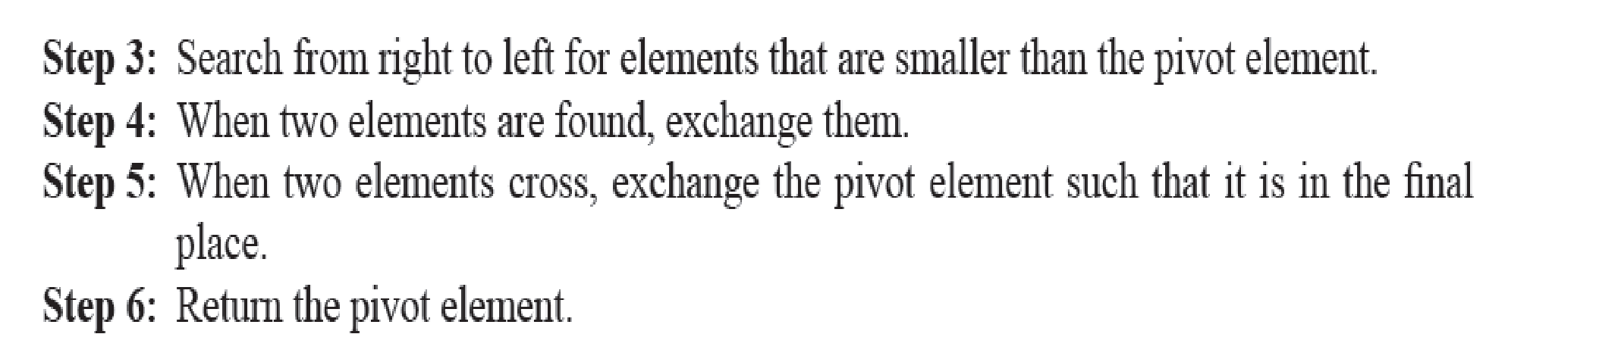
Informal Quicksort Algorithm

Slide 18
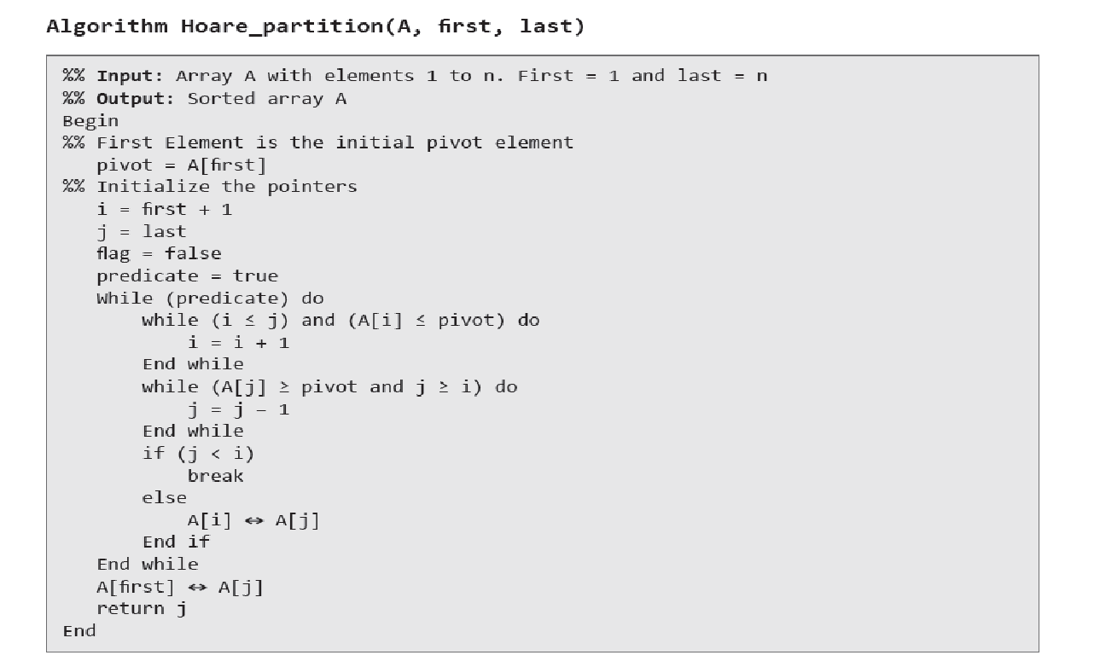
Informal Quicksort Algorithm

Slide 19
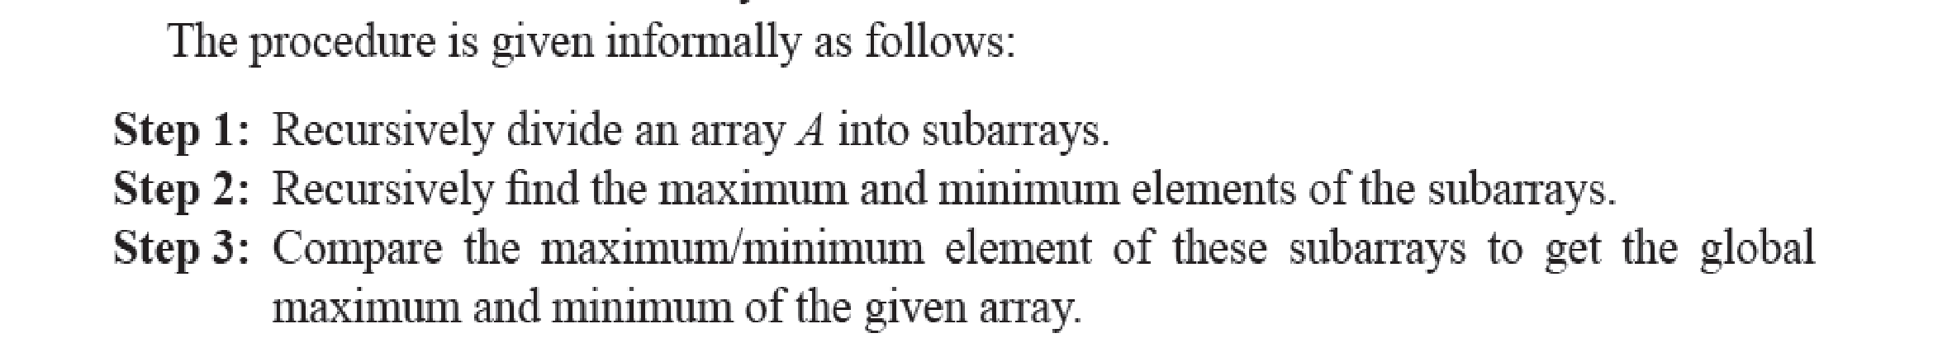
Finding Maximum and Minimum

Slide 20
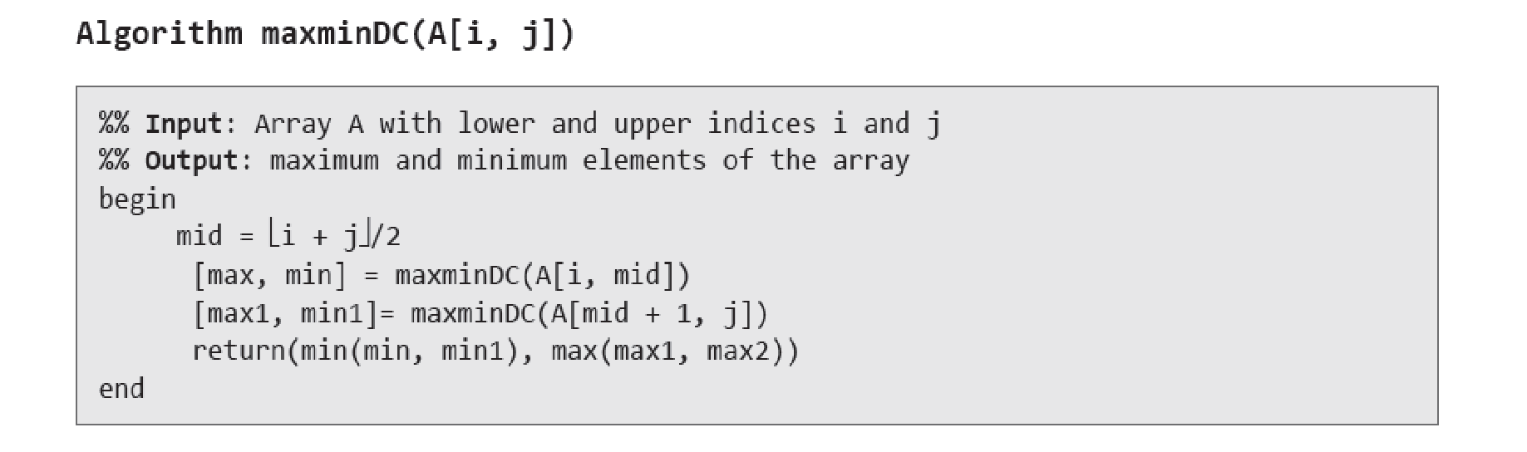
Formal Algorithm

Slide 21
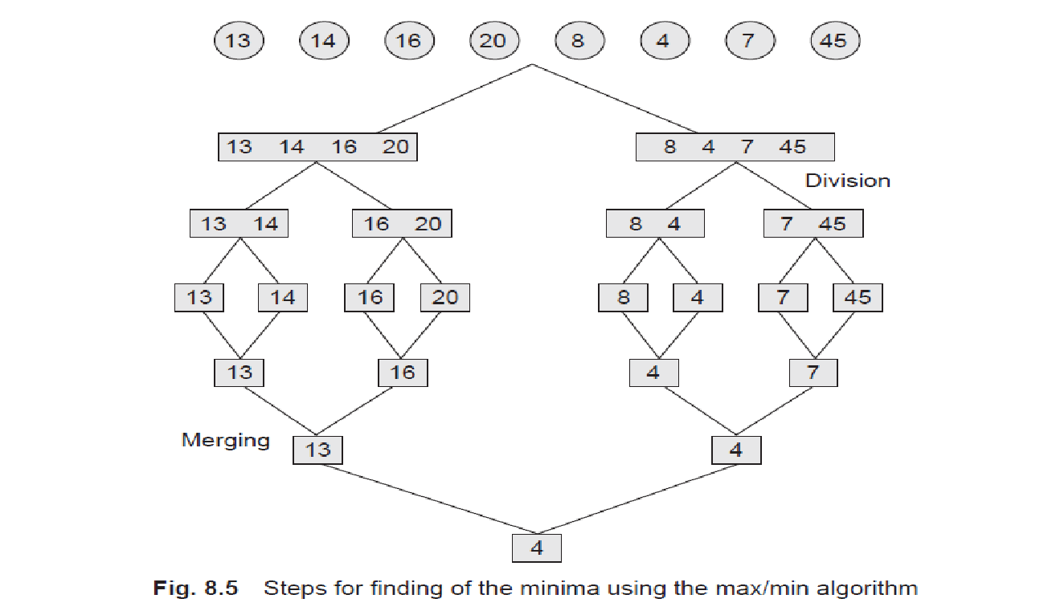
Formal Algorithm

Slide 22
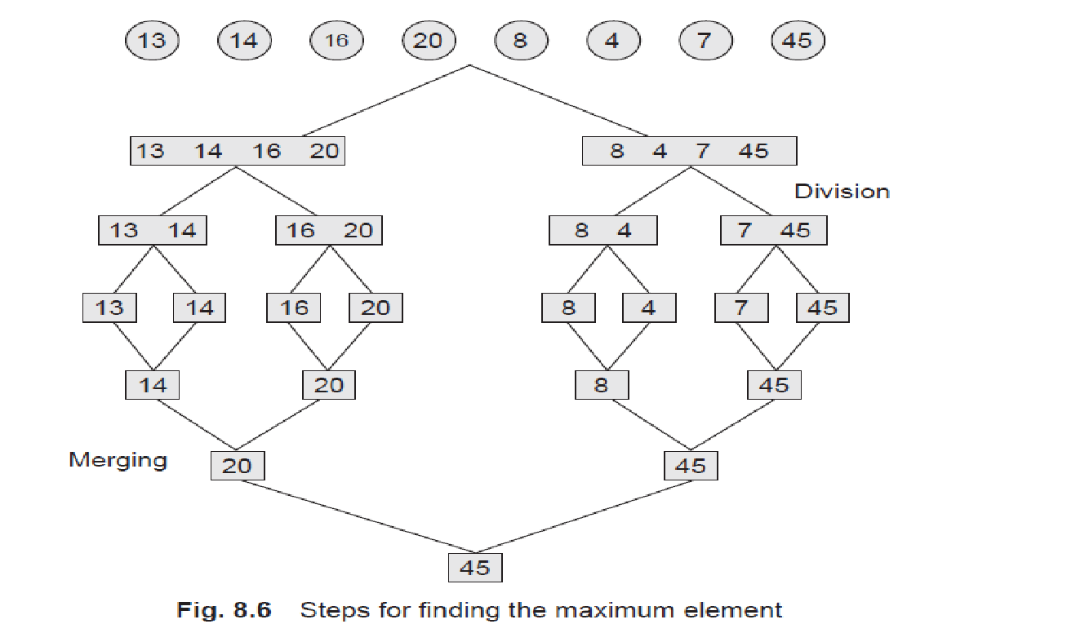
Formal Algorithm

Slide 23
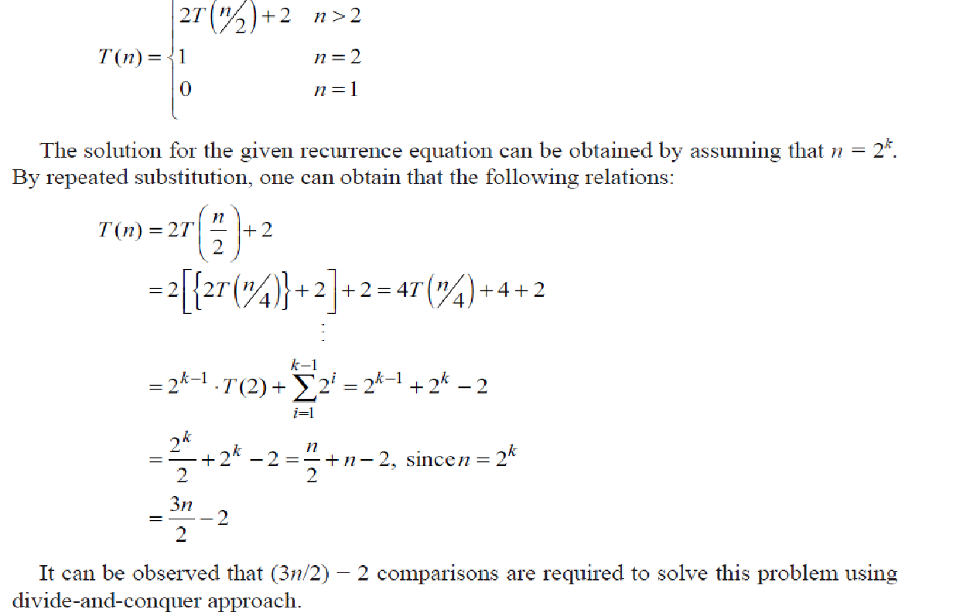
Complexity Analysis

Slide 24
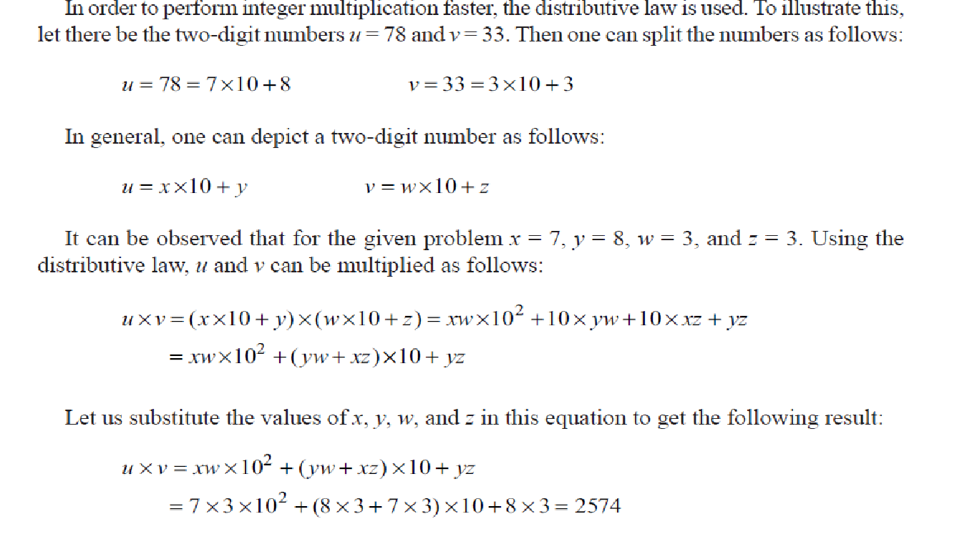
Long Integer Multiplication

Slide 25
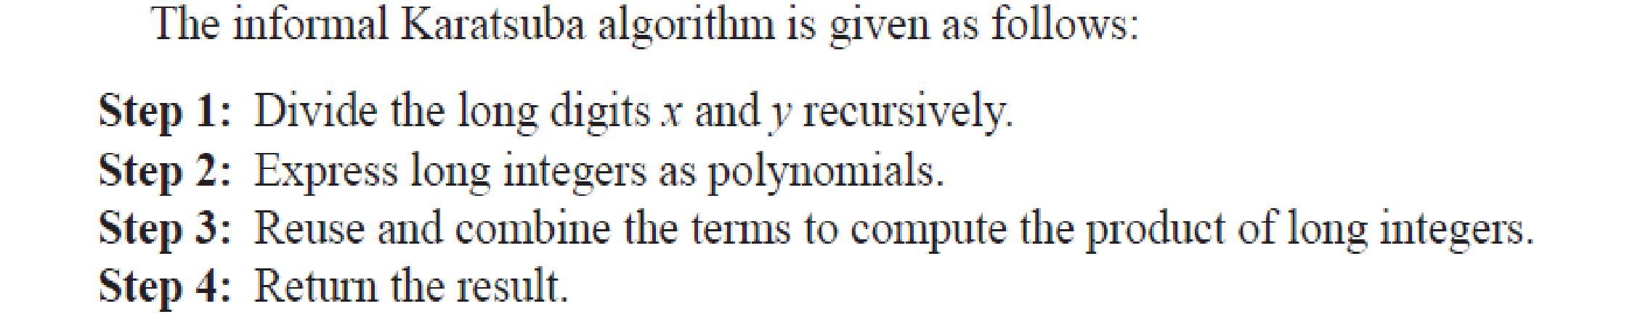
Informal Algorithm

Slide 26
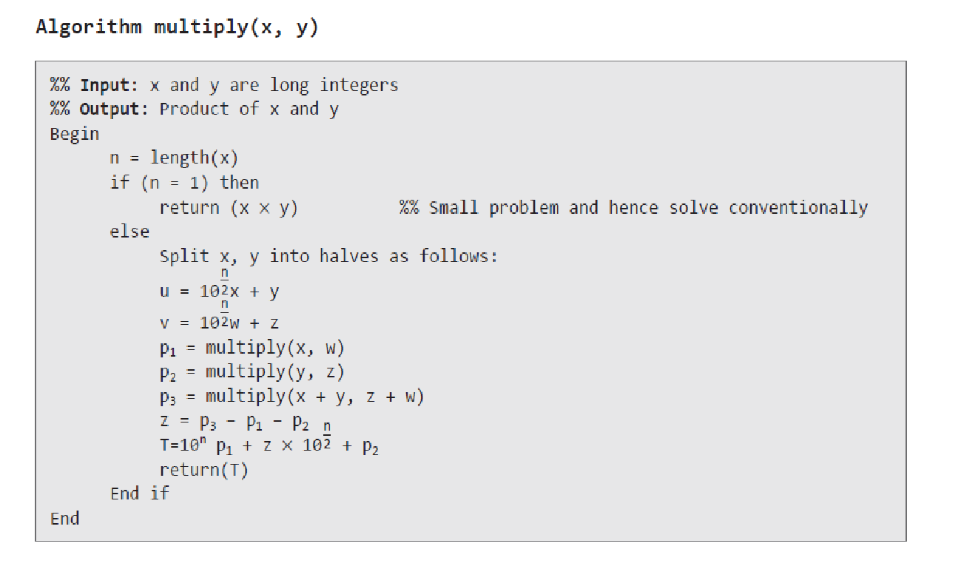
Informal Algorithm

Slide 27
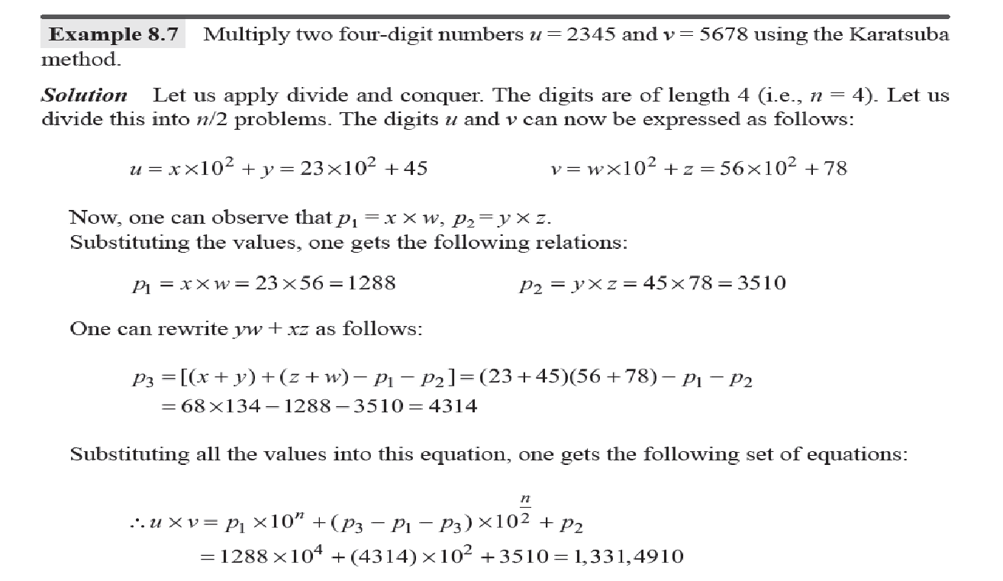
Informal Algorithm

Slide 28
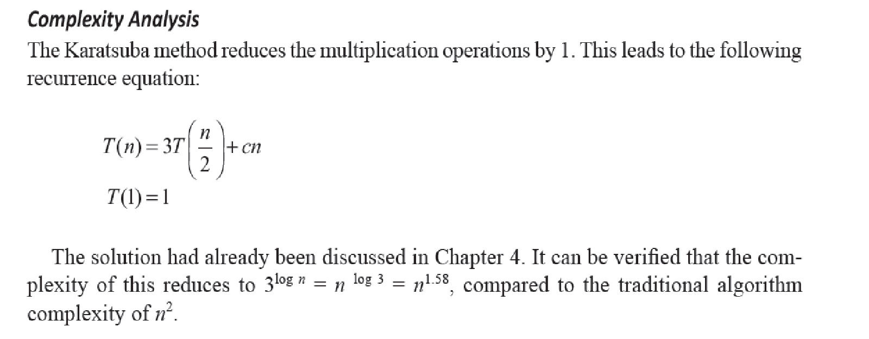
Complexity Analysis

Slide 29
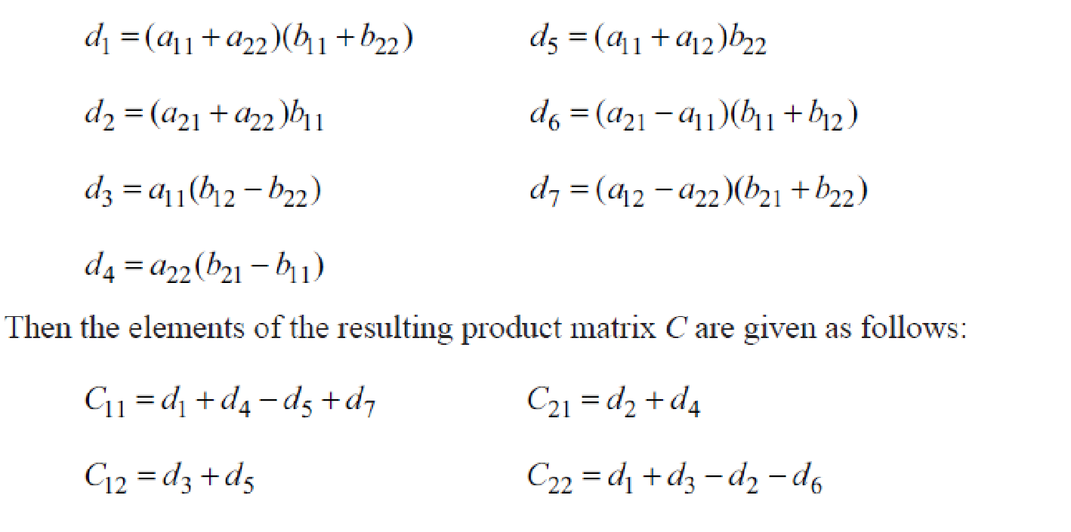
Strassen Matrix Multiplication

Slide 30
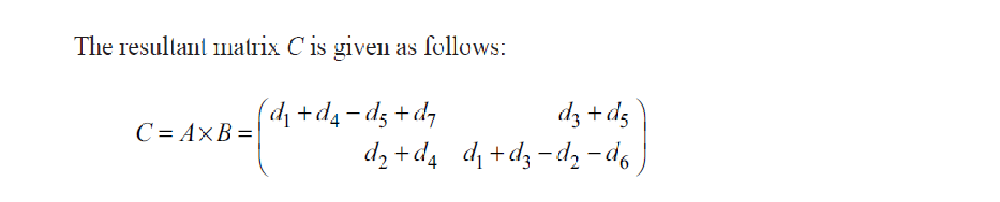
Strassen Matrix Multiplication

Slide 31
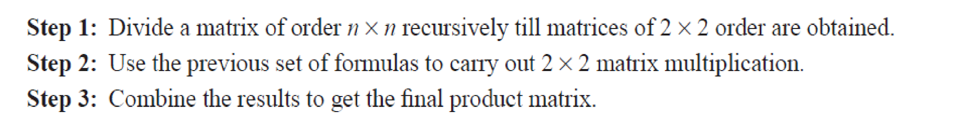
Informal Algorithm

Slide 32
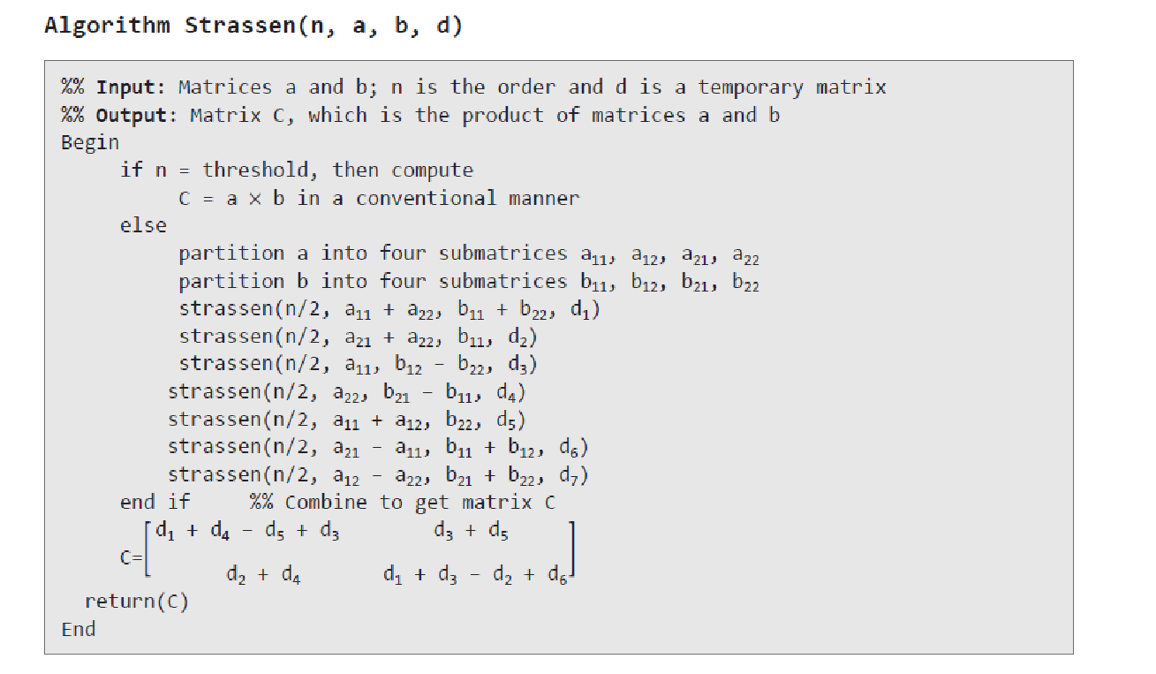
Informal Algorithm

Slide 33
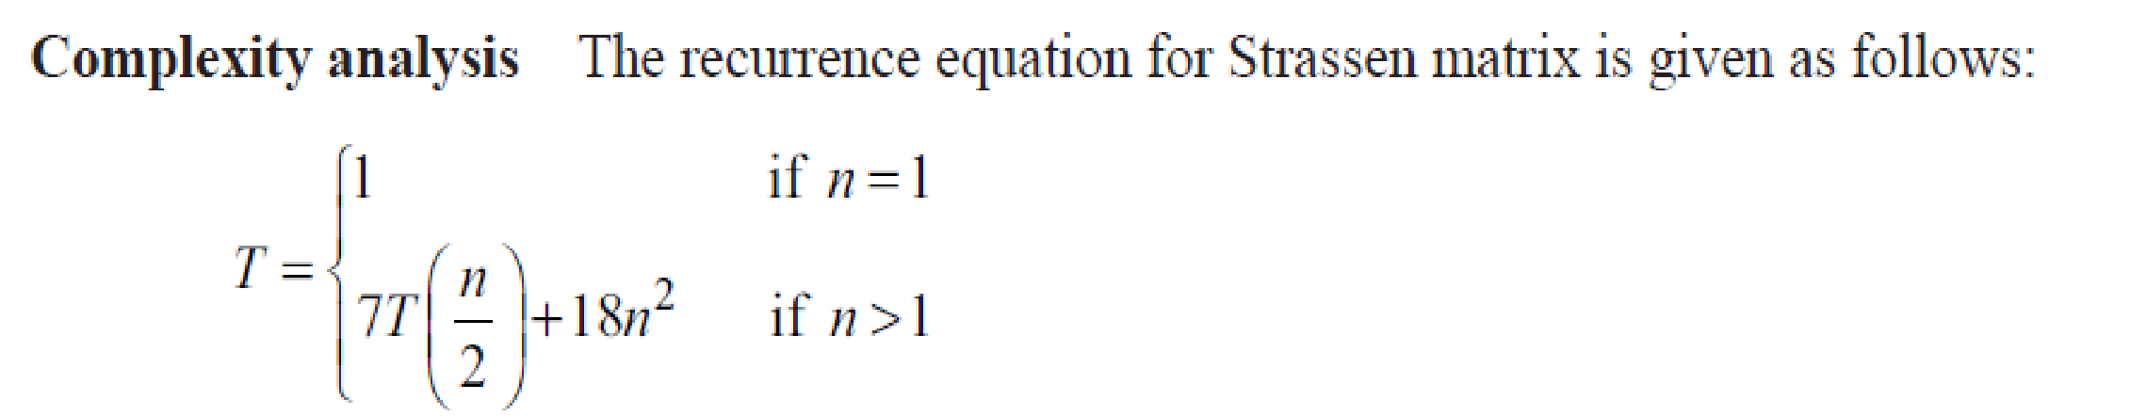
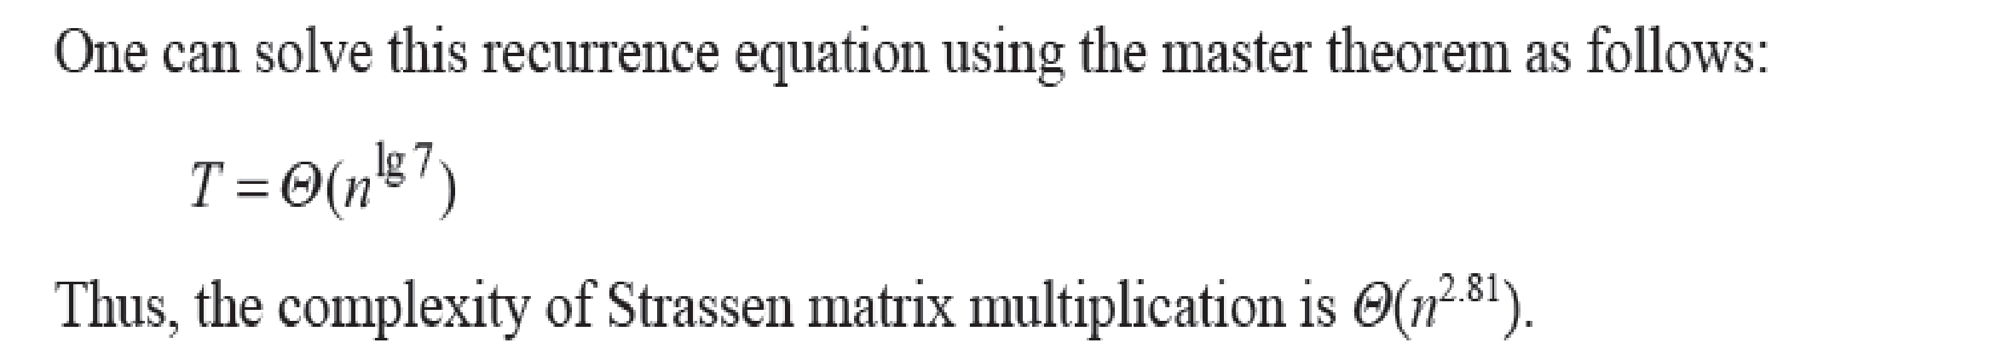
Complexity Analysis

Slide 34
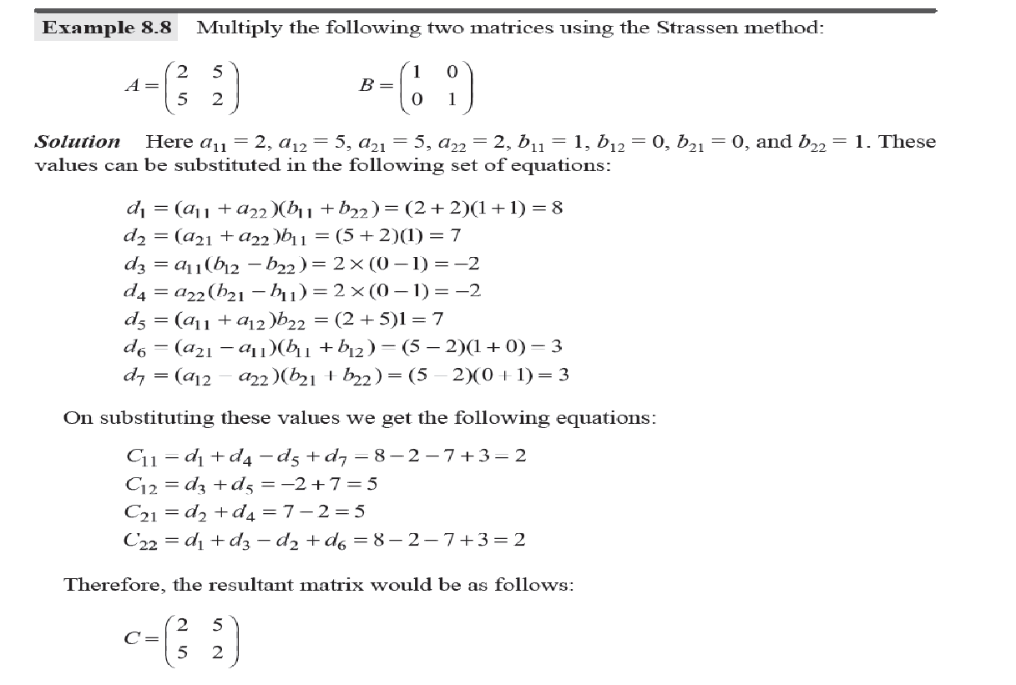
Example

Slide 35
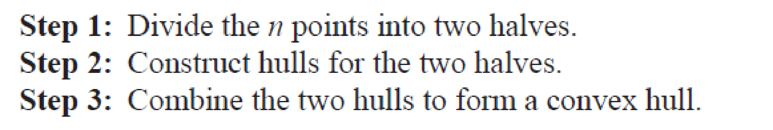
Convex Hull

Slide 36
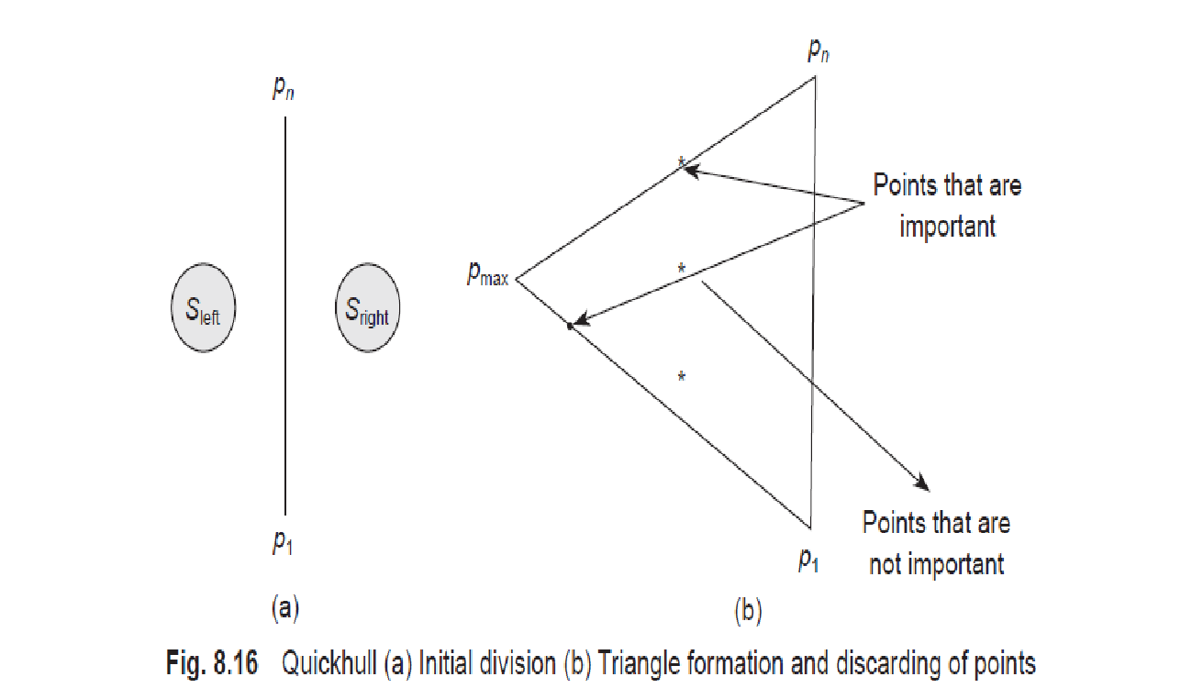
Convex Hull

